Slide 1

IndiGo Proposal

Slide 2
Market Landscape

Slide 3
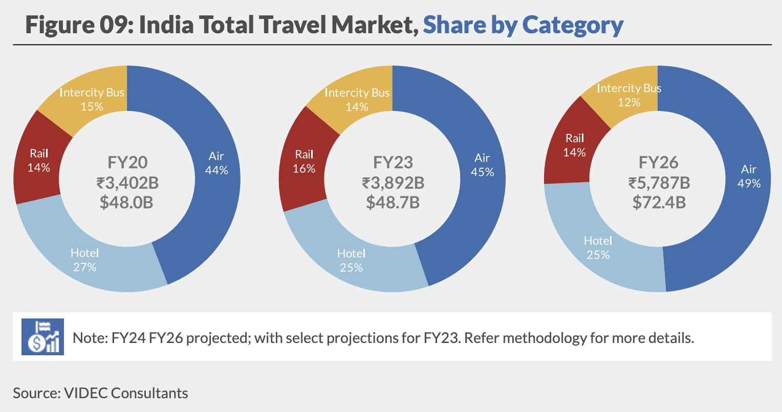
India's Skyward Surge: The Booming Air Travel Market
Air travel remains the top choice for commuters, capturing 46% of the market in 2023 and projected to grow to 49% by 2026.
With increasing passenger demand, airlines must capitalize on direct booking opportunities to maximize revenue.
Notes:
✅ Full-screen background image of an airport or an aircraft in flight.
✅ Use a simple line graph or bar chart to show market share growth from 2020 to 2026.
✅ Highlight “49% Market Share in 2026” in bold.

Slide 4
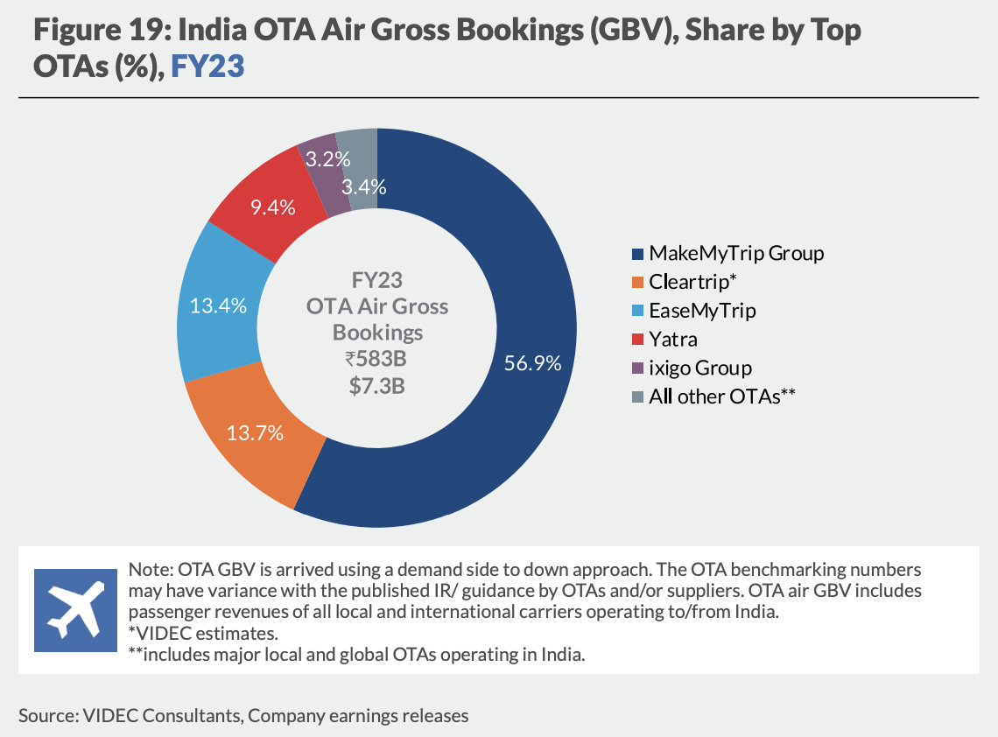
Who Owns Indigo’s Customers? The OTA Takeover
MMT (56.9%), Cleartrip, and EaseMyTrip dominate online bookings for Indigo.
A significant share of Indigo’s bookings is controlled by OTAs, limiting direct engagement with customers.
Notes:
✅ A pie chart showcasing MMT (56.9%) vs Other OTAs.
✅ MMT, Cleartrip, and EaseMyTrip logos arranged in a visual hierarchy.
✅ A small callout box: "Indigo bookings are driven by OTAs—how can we change this?"
https://videc.co/wp-content/uploads/2024/04/VIDECs-India-Travel-Market-Sizing-OTA-Benchmarking-Study-FY20-FY26.pdf

Slide 5
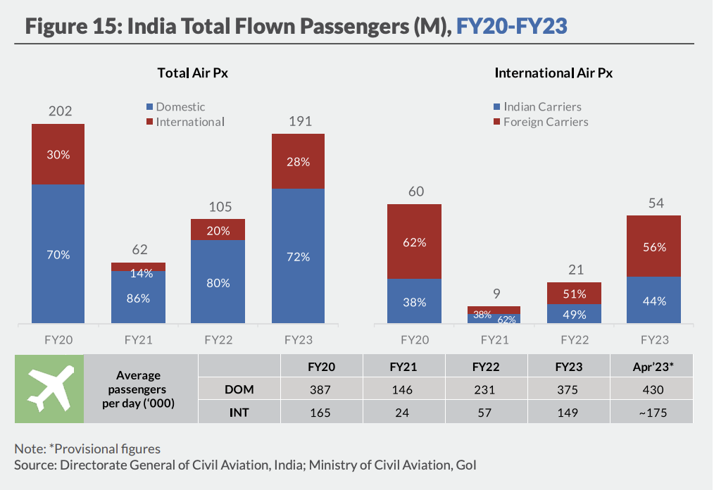
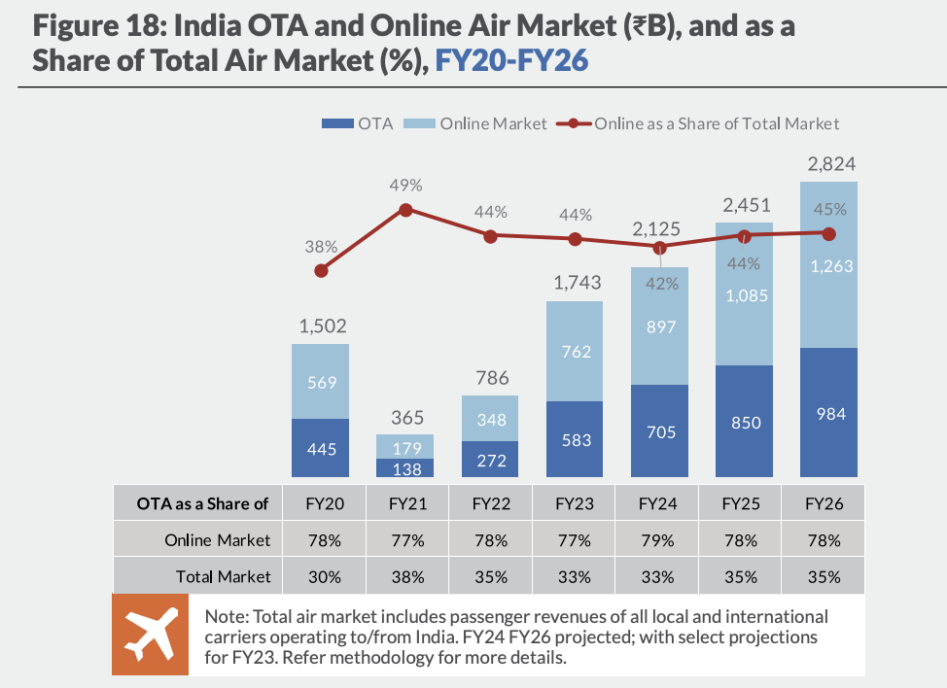
₹850B+ Bookings Happen Online… But Who Gets the Revenue?
Total Online Airline Market in 2025: ₹1,085B
OTA Market Share: ₹850B (81% of bookings)
Indigo’s Potential Market Share:
Estimated Passengers in 2025: 197M
Indigo’s Market Share (60%): 118M
Potential Direct Booking Audience: 95M passengers
A massive opportunity exists to shift OTA-dependent customers to direct Indigo bookings.
Notes:
✅ Use a flowchart-style infographic showing:
🏆 Total Market (₹1,085B)
🎟️ OTA Bookings (₹850B)
✈️ Indigo's Expected Flyers (118M)
🔥 Opportunity to Shift 95M Flyers to Direct Bookings ✅ Use a bold number (95M) in the center of the slide.

Slide 6
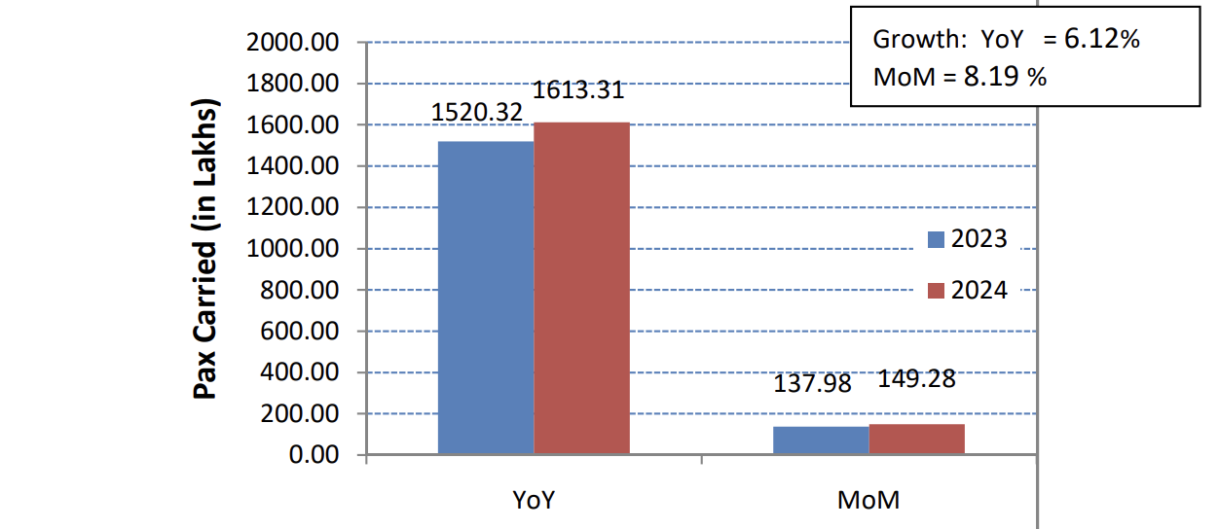
Growing, But Not Fast Enough: Unlocking the Next Level of Growth
Indigo’s YoY booking growth is 6% (152M in 2023 → 161M in 2024).
However, to accelerate growth, a stronger direct booking strategy is required.
Notes:
Design:
✅ Simple bar graph comparing YoY growth (152M → 161M bookings).
✅ A green upward arrow to signify growth.
✅ A subtle background image of an Indigo aircraft taking off.

Slide 7
Challenges and Opportunities

Slide 8
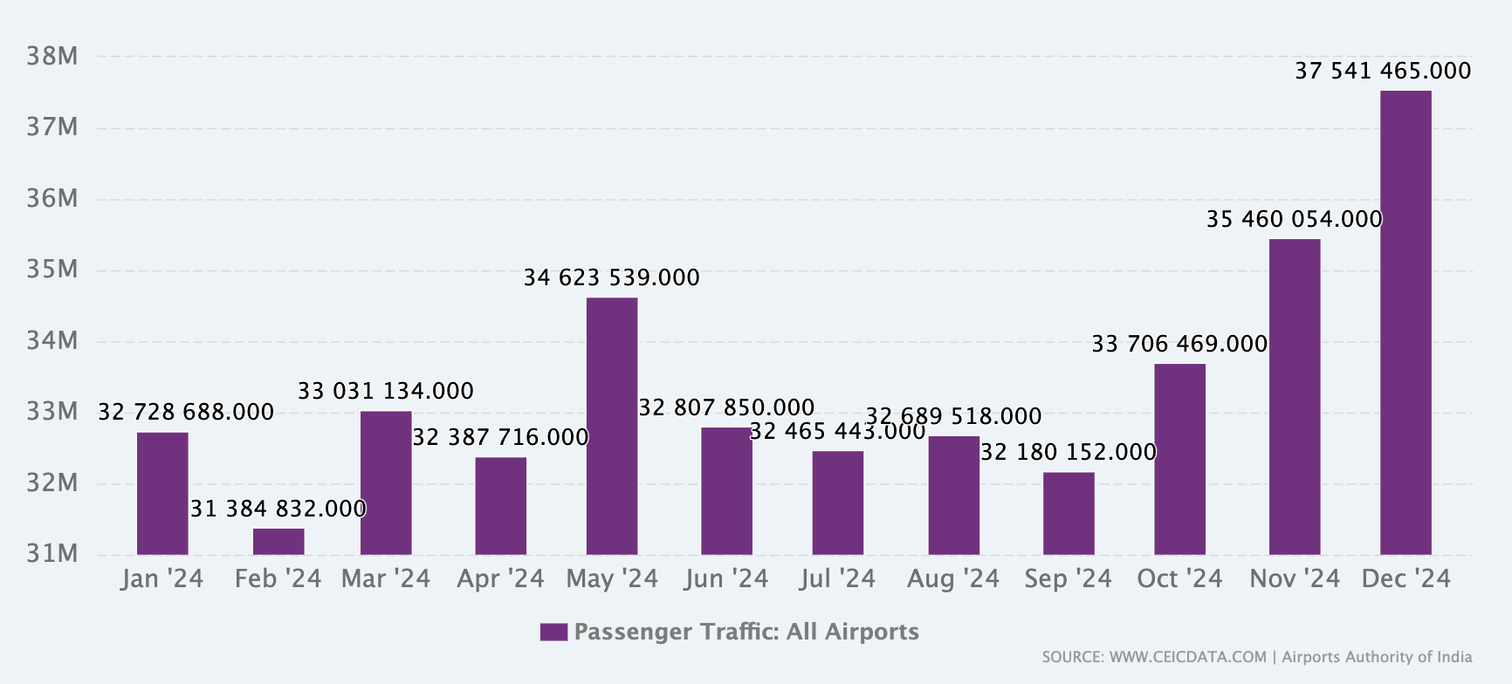
Holidays = Bookings. How Can Indigo Capture More?
Holiday and festival seasons drive significant spikes in bookings.
Capitalizing on peak seasons through targeted promotions and strategic retargeting can increase direct bookings.
Notes:
Design:
✅ Heat map or a seasonal timeline graph showing peak travel months.
✅ Icons for festivals (Diwali, Christmas, New Year, Summer Holidays, etc.).
✅ A travel surge callout box: "How can we leverage these peak periods?" https://www.ceicdata.com/en/india/airport-authority-of-india-passenger-traffic/passenger-traffic-all-airports

Slide 9
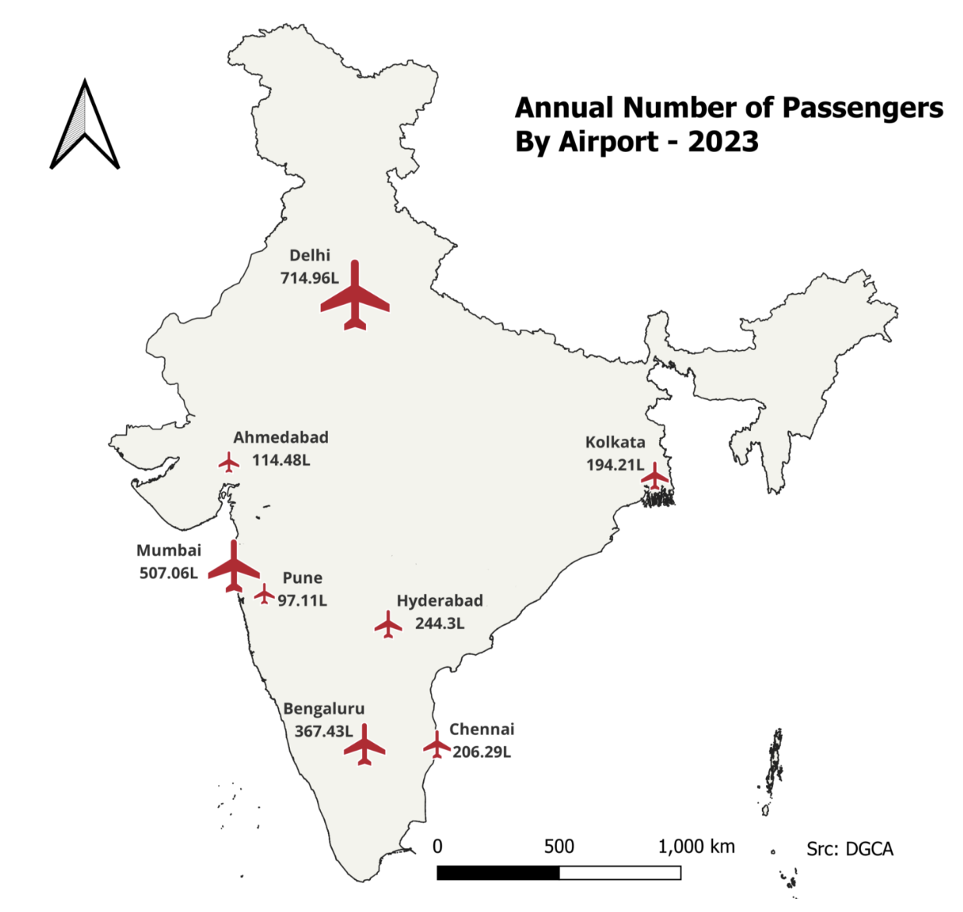
The Best Routes: Where Flyers Are Already Choosing Us
S.No. | CITY 1 | CITY 2 | PASSENGERS TO CITY 2 | PASSENGERS FROM CITY 2
TOTAL |  |  | 136028656
SUB TOTAl |  |  | 68136987 | 67891669
251 | MUMBAI | DELHI | 2,784,752 | 2,831,167
151 | BENGALURU | DELHI | 2,221,129 | 2,243,352
143 | BENGALURU | MUMBAI | 1,820,305 | 1,841,479
489 | DELHI | SRINAGAR | 1,404,653 | 1,397,251
465 | DELHI | KOLKATA | 1,396,825 | 1,307,098
450 | DELHI | HYDERABAD | 1,306,104 | 1,291,720
481 | DELHI | PUNE | 1,275,732 | 1,256,205
248 | MUMBAI | DABOLIM | 1,120,143 | 1,144,547
245 | MUMBAI | CHENNAI | 1,050,077 | 1,055,365
36 | AHMEDABAD | DELHI | 1,040,187 | 1,049,451
328 | CHENNAI | DELHI | 1,015,722 | 1,030,650
Understanding the most popular travel routes enables targeted marketing.
Personalized route-based offers can encourage direct bookings.
Notes:
Design:
✅ India map with heat spots showing top travel routes.
✅ Route names + flight volume overlay.
✅ A callout: "Personalized marketing for top routes = higher direct bookings."

Slide 10
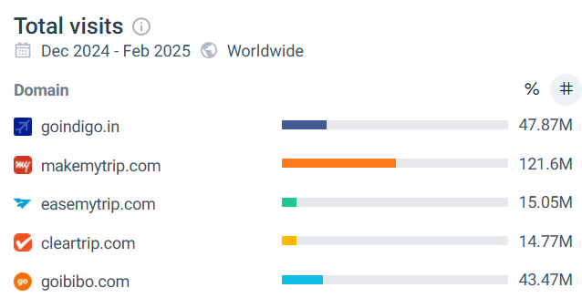
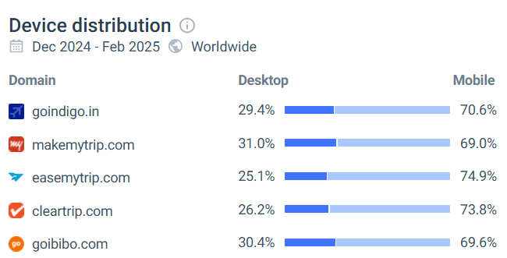
Who Gets the Clicks? Indigo vs OTAs in Web & Mobile Traffic
Mobile devices has acquired 70% of total visit which suggest the shows the app opportunity and retention
MMT has 121M visits on their website which is way high compared to other OTA’s.
MMT attracts 121M visits—far higher than Indigo’s web traffic.
Mobile accounts for 70% of visits, highlighting a major opportunity to improve the app experience & retention.
Notes:
Design:
✅ Bar chart comparing website visits (MMT: 121M vs Indigo: X).
✅ Mobile vs Desktop traffic split (pie chart or stacked bar graph).
✅ A callout: "70% Mobile Visits → Huge App Opportunity!"

Slide 11
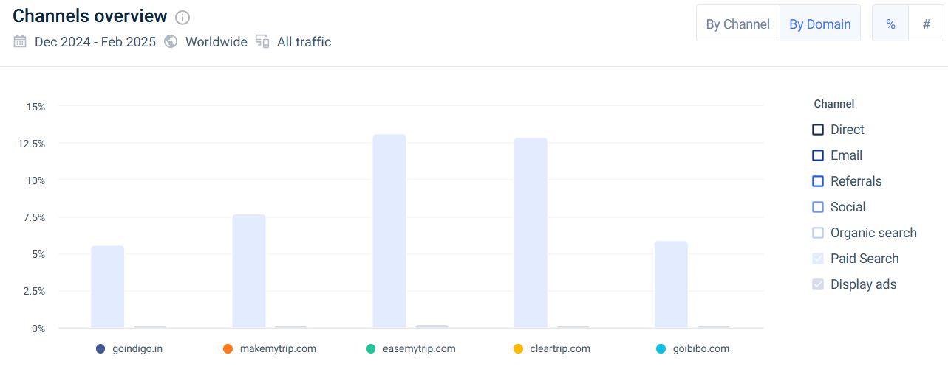
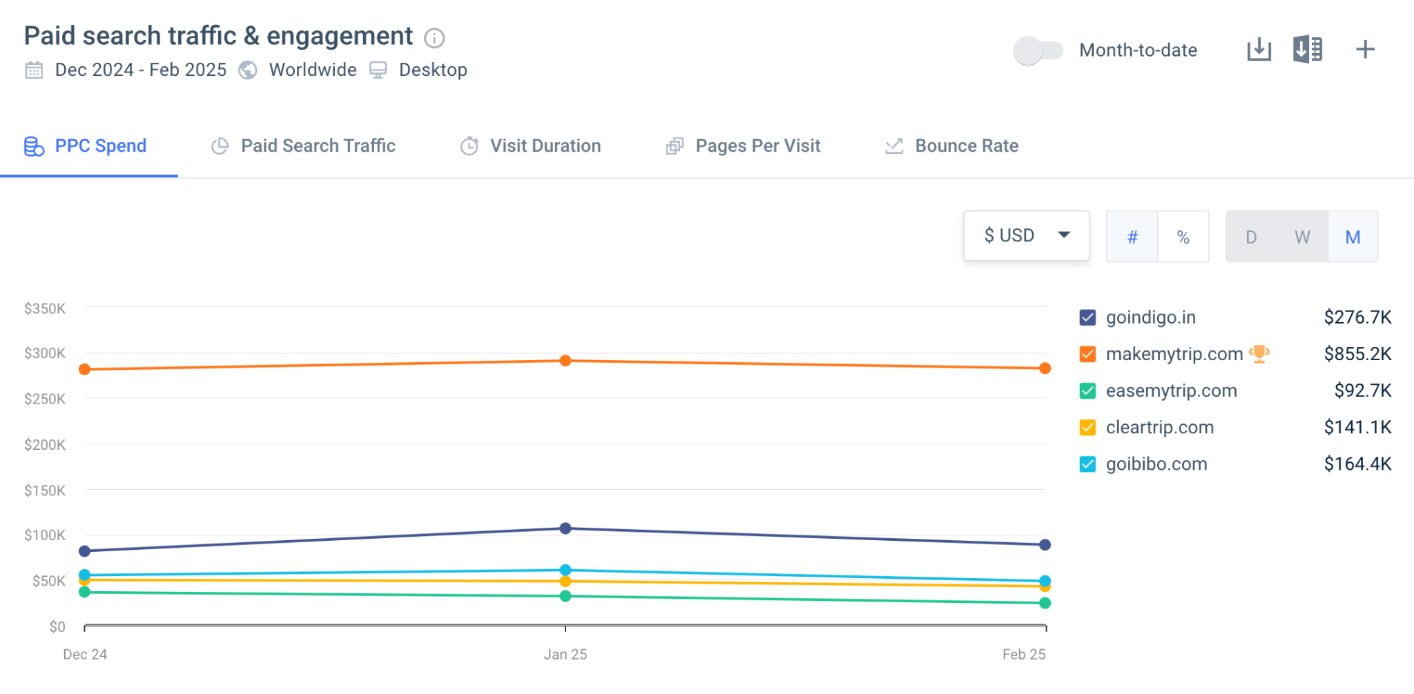
MMT’s ₹2.5Cr/Month Secret: Why Search Matters More Than Ever
Indigo’s paid traffic is significantly lower than leading OTAs.
MMT spends ₹2.5Cr per month on search ads—outpacing Indigo and driving higher acquisition.
Optimizing paid campaigns for direct bookings is critical.
Notes:
Design:
✅ Ad spend comparison bar graph (MMT: ₹2.5Cr/month vs Indigo: ₹X).
✅ A Google search screenshot highlighting Indigo’s limited visibility.
✅ A callout: "Outspending us = Outbooking us. How do we fight back?"

Slide 12
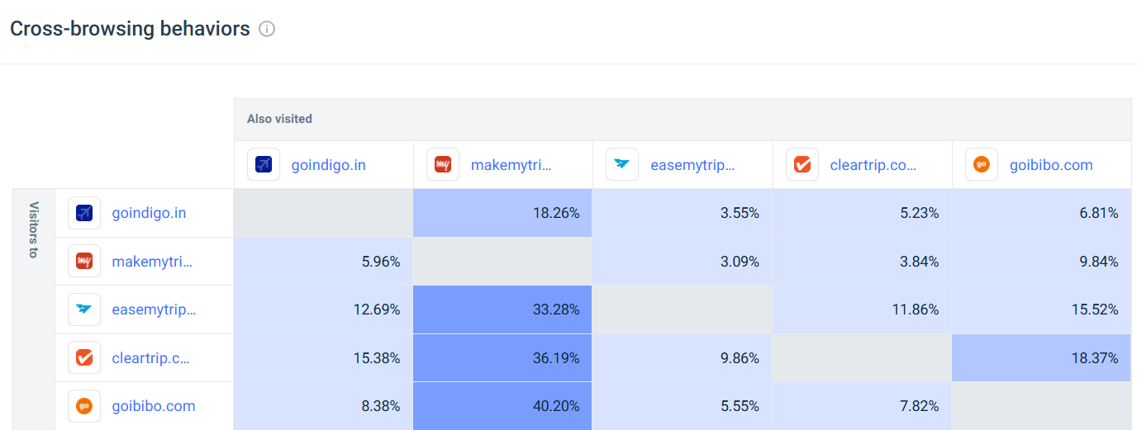
They Visit Us… But Book Elsewhere. How Do We Stop This?
18% of Indigo’s visitors abandon and book via MMT, while only 5% of MMT users switch to Indigo.
This signals a gap in user retention and experience on Indigo’s digital platforms.
Improving website & app usability can reduce drop-offs and improve conversion rates.
Notes:
Design: ✅ Sankey diagram showing visitor flow:
18% Drop from Indigo → MMT
Only 5% Drop from MMT → Indigo ✅ A callout: "We’re losing high-intent customers. Time to fix the leaks!"

Slide 13
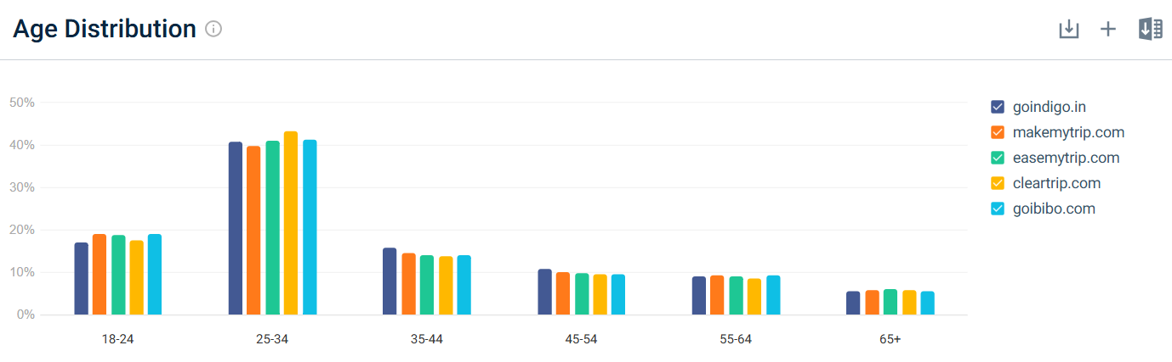
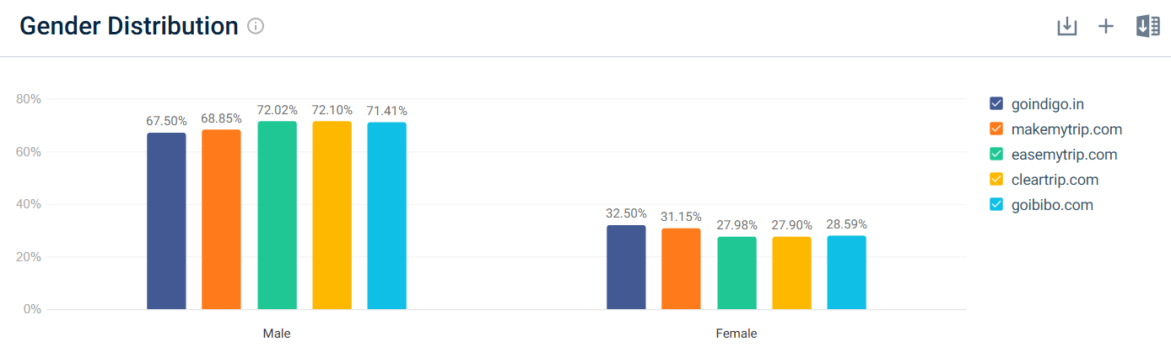
Who Books Indigo? And How Can We Get More Like Them?
70% of Indigo’s audience are males aged 18-34.
Key customer segments:
Students & Young Professionals
Adventurers & Honeymooners
Entrepreneurs & Frequent Flyers
Targeted campaigns & messaging can boost direct engagement.
Notes:
Design:
✅ Demographic infographic (Male 70%, Age 18-34, Audience personas).
✅ Icons representing each segment (Students, Entrepreneurs, etc.).
✅ A callout: "Targeting the right audience = More direct bookings."

Slide 14
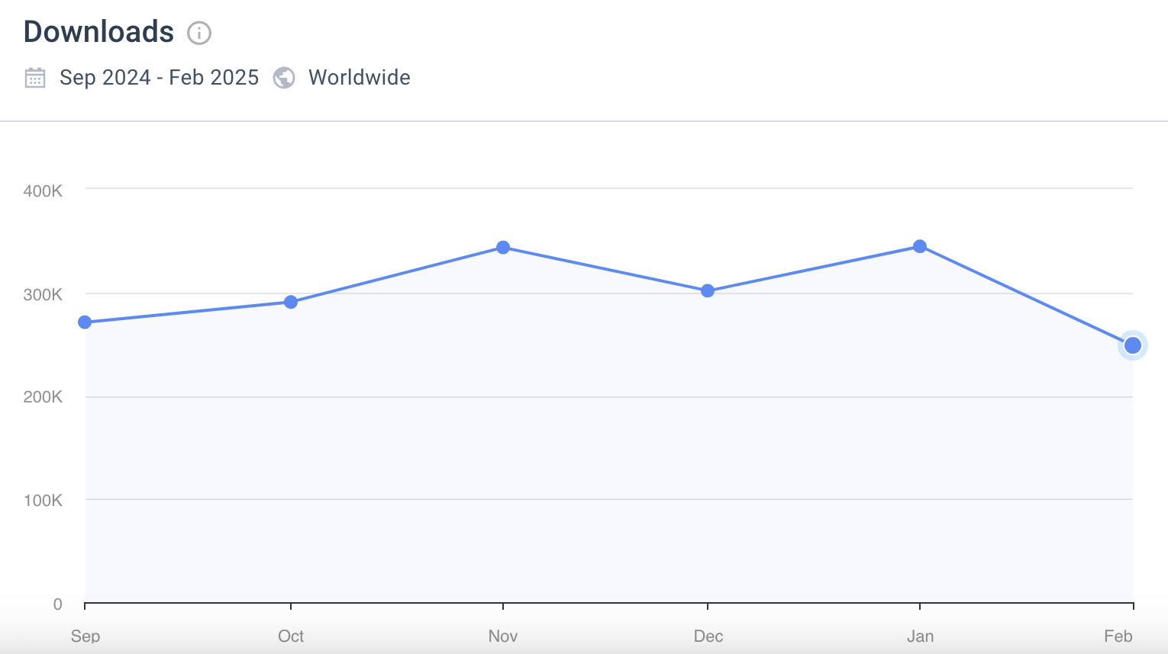
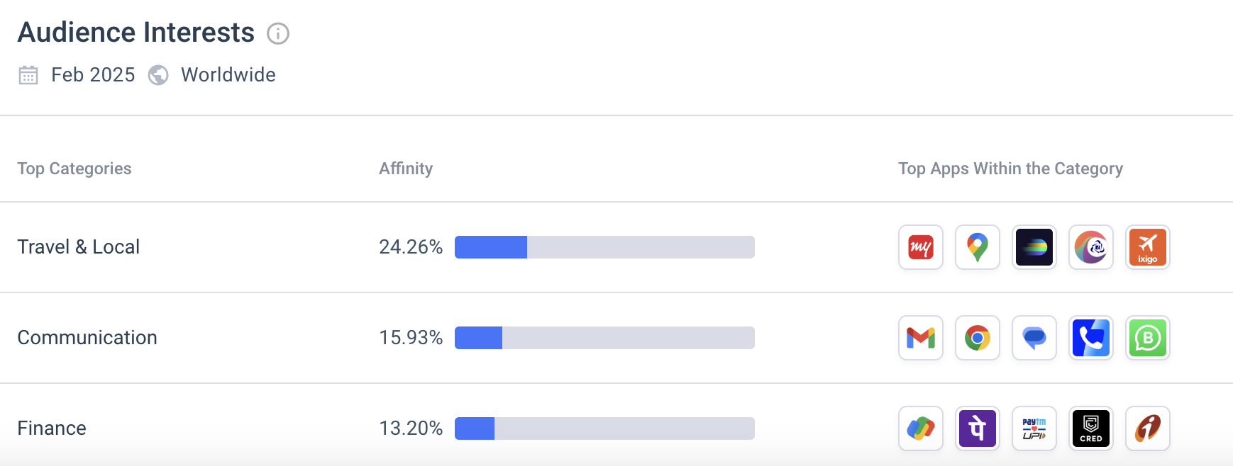
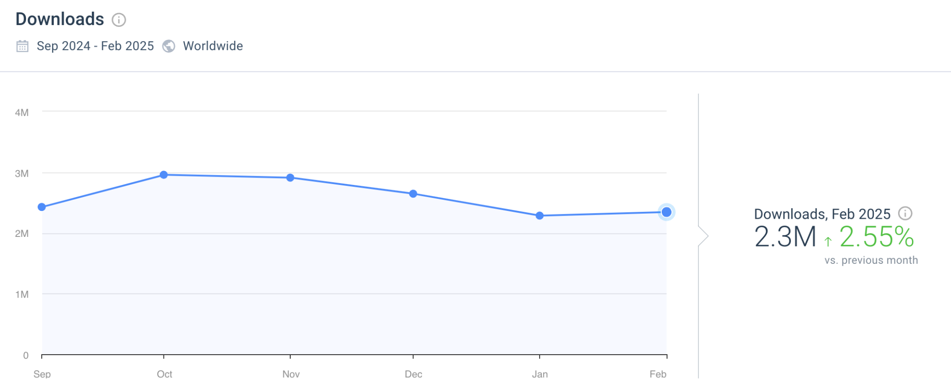
Mobile First, But App Last: Why Indigo Must Win on Phones
Indigo’s app downloads are declining, while MMT’s app installs have surged over the last 5 months.
With mobile contributing to 70% of traffic, low app adoption hinders direct booking growth.
A robust mobile-first strategy is essential to reverse this trend.
There are 1M air traveler audiences who has MMT apps which is way higher compare to Indigo
Notes:
Design:
✅ Two app download trend lines (Indigo declining vs MMT rising).
✅ A smartphone mockup showing MMT app dominance.
✅ A callout: "More mobile users, but fewer downloads—why?"

Slide 15
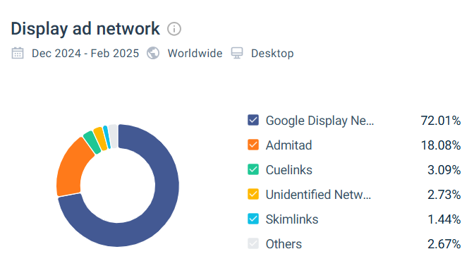
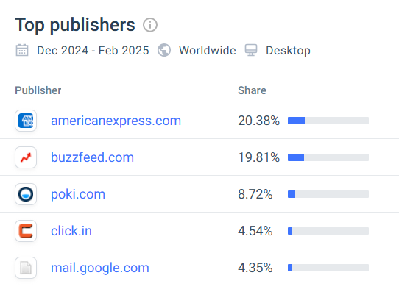
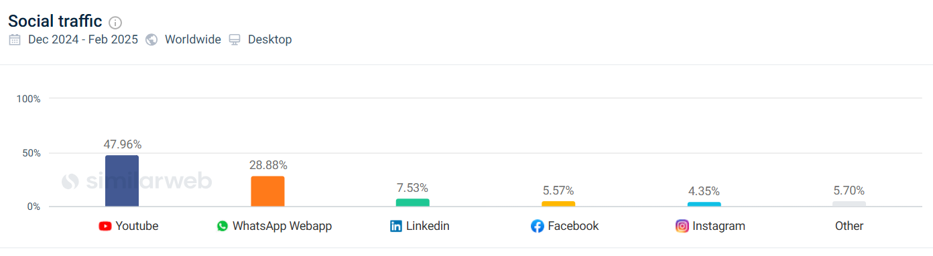
How MMT’s Video & Display Strategy Drives Millions in Bookings
MMT heavily invests in video ads, top display networks, and social traffic acquisition.
Indigo must leverage multi-channel digital advertising to compete effectively.
Notes:
Design:
✅ Ad placement map (MMT’s top ad networks).
✅ Comparison of display ad formats (Video vs Static).
✅ A callout: "Time to invest in high-impact ad formats."

Slide 16
From 19% to 40%: Indigo’s Direct Booking Breakthrough
✅ Convert OTA Users & Frequent Flyers into Direct Bookers
✅ Retarget First-Party Data (Frequent Flyers, OTA Users, Web Abandoners, App Installers)
✅ Expand into New Customer Segments for Sustainable Growth
✅ Optimize Weekly Based on ROAS & Conversion Rates
Notes:
Design: ✅ 4-part visual strategy roadmap:
Convert OTA Users
Retarget First-Party Data
Expand New Segments
Optimize for ROAS & Conversions ✅ Arrows leading to the goal: “40% Direct Bookings”

Slide 17
Audience Segmentation

Slide 18
Understanding Our Flyers: The Key Audiences Driving Direct Bookings
Frequent Flyers
Loyal travellers such corporate flyers booking from OTA and Web
OTA Users
Customers booking Indigo from MMT, Goibibo, Cleartrip and Easemytrip
High Traffic Routes
New audience for high traffic routes popular for Indigo and other airlines such Delhi to Mumbai, Srinagar to Delhi
App (inactive/first timer)
Indigo app users, who haven’t booked in last 60-90 days and gone inactive after first booking
Website Visitors(abandoned booking)
All the visitors who have search flight on Indigo website but didn’t booked
Price Sensitive Flyers
Flyers who are more concerned about the deals such as Student and
First time Flyer
Flyer from the hyperlocal region who has booked first time Indigo flight
Competitor Airline Flyer/Look alike Audience
Audience similar to our customers who are booking with competitor airline
Notes:
Design Suggestions:
✅ Use a persona-based layout – Each audience segment should have a visual (icon or image) with a short description.

Slide 19
Full Funnel Strategy

Slide 20
From Awareness to Loyalty: Indigo’s Full-Funnel Growth Strategy
Lifecycle Stages
Goal
Audient Segments
Channels
Budget Allocation
Performance Measurement
- OTA Users (New Travelers & Frequent Flyers)
- Competitor Airline Flyers (Google Search & Meta Audiences)
- Price-Sensitive Flyers (Deal-Seeking Audience)
- High-Traffic Routes)
- Regional & Tier 2/3 City Flyers
- Google Display Ads (Competitor & Route Targeting)
- Meta Ads (Broad Travel Interest)
- YouTube Ads (Brand Awareness)
- Influencer & Regional Ads (For Tier 2/3 Users)
20%
- Impressions (Google Display, Meta, YouTube)
- Reach & Engagement (Social Ads)
- App Install Rate (Google UAC, Meta Ads)
- Attract new users & educate them about direct booking benefits
- Promote Indigo App Installs for a seamless experience
Awareness
- OTA Users Who Searched for Flights But Didn’t Book
- Competitor Airline Users and Lookalike
- First-Time Indigo Flyers (Web & App Visitors)
- Web Users Who Haven’t Installed the App Yet
- Google Search Ads (Competitor + OTA Keyword Bidding)
- LinkedIn Ads (Corporate Travelers)
- Email & WhatsApp Marketing (Custom Deals)
- Retargeting Ads (Meta, Google, Display)
30%
- CTR on ads (Google Search, Display, Meta)
- Website Visit-to-Search Conversion Rate
- App Install-to-Booking Conversion Rate
- Convert OTA users into direct bookers
- Push existing web users to switch to app bookings
Consideration
- Frequent Indigo OTA Flyers
- Visitors Who Started Booking But Abandoned Checkout
- Users Who Booked in the Past But Haven’t Rebooked
- New App Users Who Haven’t Made Their First Booking
- Past Direct Bookers Who Haven’t Rebooked
- Frequent Flyers Who Book Partially on OTAs
- Users Who Installed the App But Haven’t Booked Again
- Business Travelers With Repeat Patterns
- Google Dynamic Retargeting Ads (Abandoned Search Recovery)
- App Push Notifications (For Non-Bookers)
- WhatsApp & SMS Offers (Urgency Messaging)
- Exit-Intent Popups on Website
- Email & WhatsApp Retention Campaigns
- Loyalty Program Ads (Google & Meta)
- Personalized Offers via SMS
50%
Get users to book directly instead of OTAs
- Increase repeat direct bookings
- Improve App Retention Rate to keep users engaged & prevent OTA leakage
- Direct Booking Conversion Rate (Website & App)
- ROAS (Return on Ad Spend)
- Cost Per Acquisition (CPA) for direct bookings
- % of Bookings from App vs. Website
- Repeat Booking Rate
- LTV (Lifetime Value) of Direct Bookers
- Loyalty Program Enrollment Rate
- App Session Frequency & Push Notification Engagement
Conversion
Notes:
Design:
✅ A funnel diagram with four stages (Awareness, Consideration, Conversion, Retention).
✅ Icons or visuals representing each stage (e.g., megaphone for awareness, handshake for consideration, checkout cart for conversion, loyalty badge for retention).
✅ A budget allocation breakdown (20%-20%-50%-10%) in a clear and concise format.
✅ Highlight Key Results Indicators (KRIs) using icons and short phrases.

Slide 21
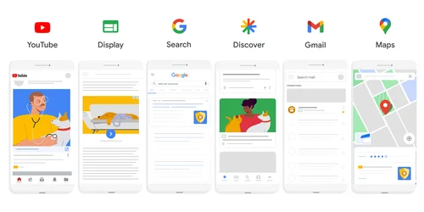
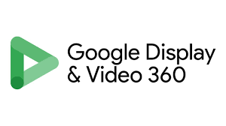

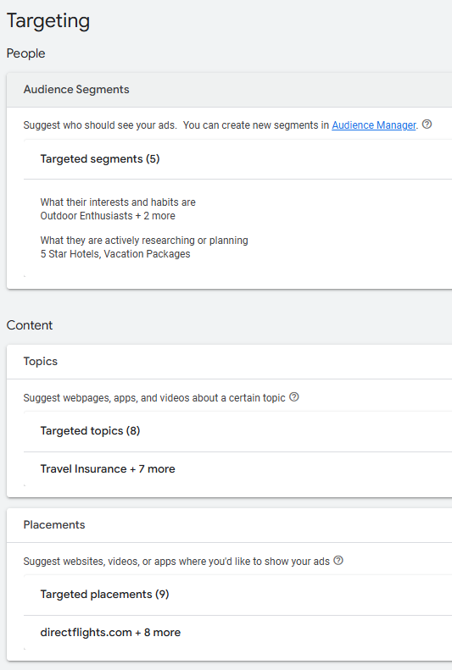
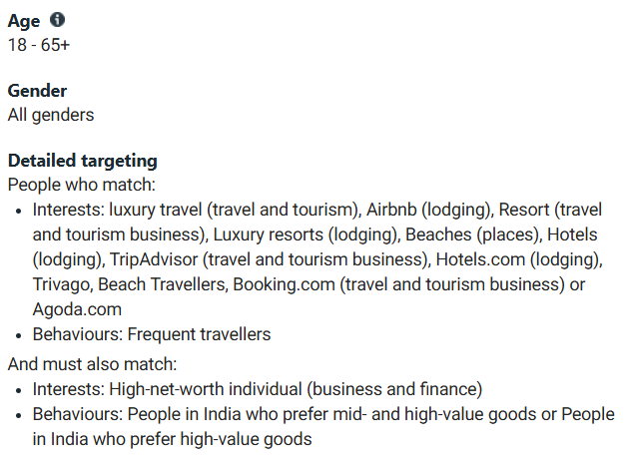
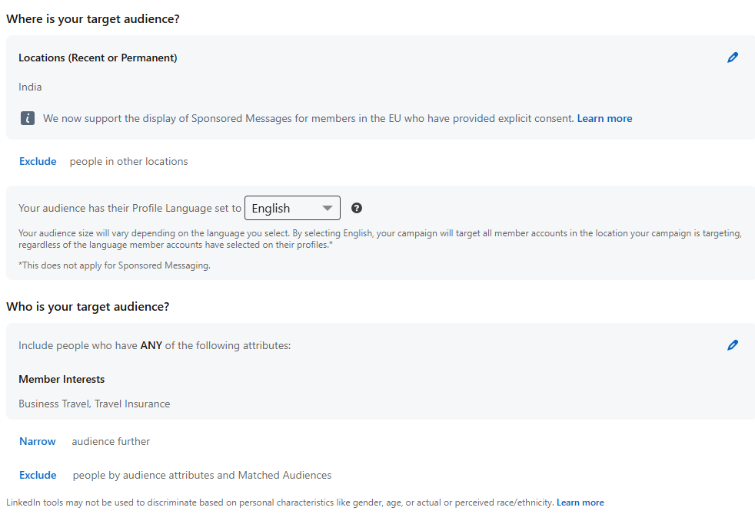
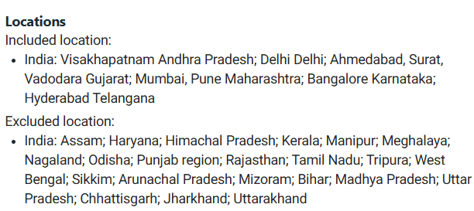
Getting Noticed: How We Create Awareness & Educate Flyers
Objective: Capture attention, increase brand recall, and educate users on the benefits of direct bookings via the IndiGo website.
Advertising Channels
Audience Targeting
In-Market Audience Segments (People who are actively researching on specific topics)
Affinity Audience (People who have shown interest)
Keyword Targeting
Placement Targeting
Topic Targeting
20% of Overall Budget
Notes:
Design:
✅ A visual roadmap showing awareness channels (Google Display, YouTube, Meta Ads, etc.).
✅ A heat map or flowchart illustrating audience segmentation (In-Market, Affinity, Keyword, Topic, Placement Targeting).
✅ Boldly display “20% of Budget” to reinforce allocation.

Slide 22
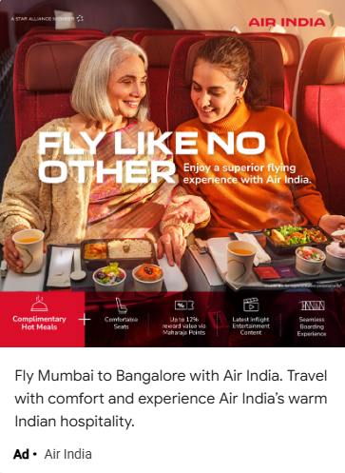
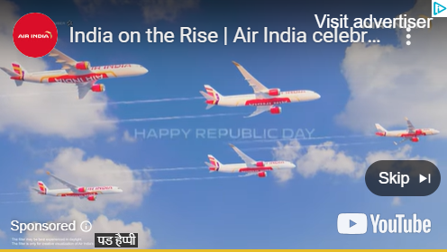
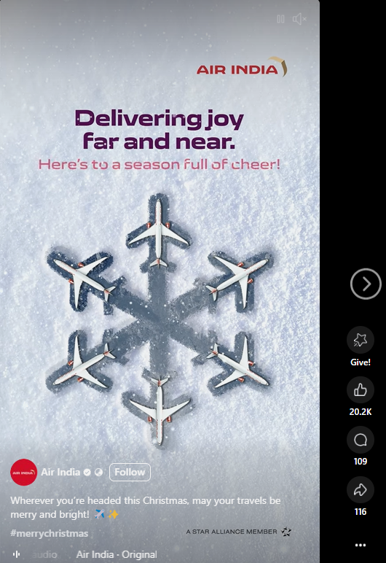
Visual Impact: The Ads That Drive Awareness
Youtube Ad
Display & Discovery Ads
Social Awareness Ads (Reels & Story)
Key Messaging Suggestion - Travel with Comfort and Experience IndiGo’s warm Indian Hospitality
Notes:
Design:
✅ Showcase high-impact ad visuals from the awareness stage.
✅ Use a mockup of an actual ad campaign (Google Display, YouTube bumper ad, Instagram story ad, etc.).
✅ Callout for key messages used in ads.

Slide 23

Why Book Direct? Convincing Flyers to Choose Indigo Over OTAs
Objective: Move users further down the funnel by demonstrating why booking on IndiGo’s website is better than OTAs.
Audience Targeting
Retargeting the existing OTA IndiGo bookers
Dynamic Remarketing (Website Visitors)
Keyword Targeting (Flight searchers, OTA searchers, competitor airlines searchers)
Interest and Demographic based targeting on LinkedIn to target Business Travellers
Advertising Channels
20% of Overall Budget
Notes:
Design: ✅ A comparison table showing why Indigo’s website is better than OTAs (e.g., Price Transparency, Rewards, Direct Support, Early Check-ins, No Hidden Fees). ✅ Flowchart showing how remarketing works (Website Visitors → Dynamic Remarketing → Personalized Offers). ✅ Icons representing different targeting methods (Retargeting, LinkedIn Business Travelers, Search Intent, etc.). ✅ Emphasize “20% of Budget” for clear resource allocation.

Slide 24
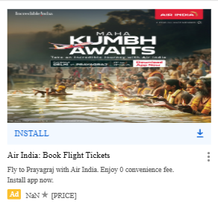
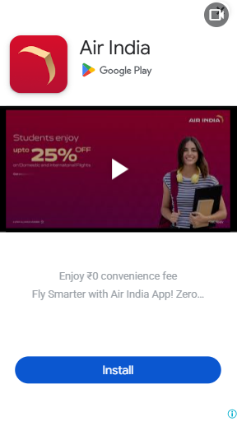
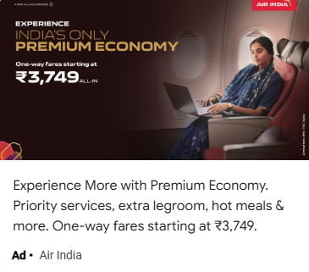
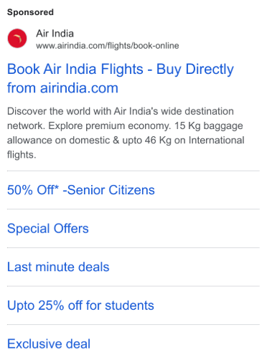
Driving Consideration: How Our Ads Persuade Travelers
Retargeting Banner Ad
App Install Image Ad
App Install Video Ad
Search Ad
Key Messaging Suggestion - Book directly with Indigo & get lower fares, app-only offers & priority support!
Notes:
Design:
✅ Showcase retargeting & LinkedIn ad creatives.
✅ Use a carousel-style layout to highlight different ad formats (text ads, video ads, static banners).
✅ A bold CTA (Book Direct & Save!) in each visual.

Slide 25
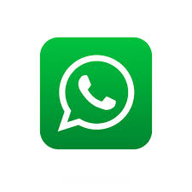
Final Step: Converting Interest into Direct Bookings
Objective: Move users further down the funnel by demonstrating why booking on IndiGo’s website is better than OTAs.
Advertising Channels
Audience Targeting
High Intent Users
Frequent Flyers
Existing OTA audiences
Cart Abandoners
Keyword targeting (OTA Branded Search “IndiGo flights on MakeMyTrip”)
50% of Overall Budget
Notes:
Design:
✅ A simple three-step flow (Search → Compare → Book) showing how users go from interest to booking.
✅ A bar graph showcasing Indigo’s past conversion success rates vs OTAs.
✅ Icons representing high-intent audiences (Frequent Flyers, Cart Abandoners, OTA Searchers, etc.).
✅ Large, bold “50% of Budget” to emphasize importance.

Slide 26
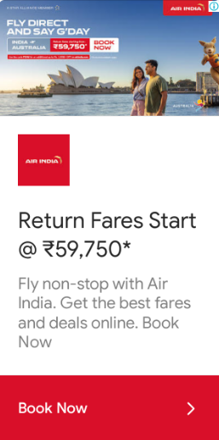
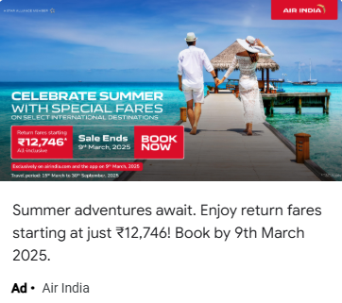
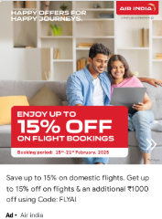
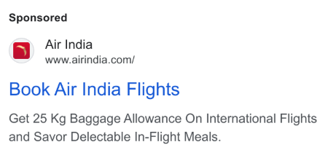
Sealing the Deal: The Conversion-Focused Ads That Drive Revenue
Search Ads - OTA Branded Search Capture (Bidding on “IndiGo flights on MakeMyTrip”)
Loyalty Ads (Exclusive IndiGo deals for frequent flyers)
Remarketing Ads (Abandoned cart, price drop alerts)
Key Messaging Suggestion - Book Direct for Faster Refunds & Priority Support!
Notes:
Design:
✅ Highlight urgent messaging in creatives (“Limited Offer!”, “Lowest Fares Only on Indigo Website!”).
✅ Use a mockup of Indigo’s website checkout flow to demonstrate the seamless booking experience.
✅ Show dynamic search ads targeting OTA brand search (e.g., “Indigo Flights on MakeMyTrip” redirecting to Indigo’s site).

Slide 27
Turning One-Time Flyers into Loyal Customers
Objective: Move users further down the funnel by demonstrating why booking on IndiGo’s website is better than OTAs.
Advertising Channels
Audience Targeting
Past Converters
Frequent Flyers from IndiGo
Inactive or Lapsing Customers
Users Who Previously Searched or Abandoned Booking
10% of Overall Budget
Notes:
Design:
✅ Loyalty-based segmentation (Past Converters, Frequent Flyers, Lapsing Customers, etc.).
✅ Use a cycle diagram to show continuous engagement (Email → Personalized Offers → App Push Notifications → Exclusive Deals).
✅ Show Indigo’s mobile app as a retention tool.
✅ Clearly state “10% of Budget” for retention efforts.

Slide 28
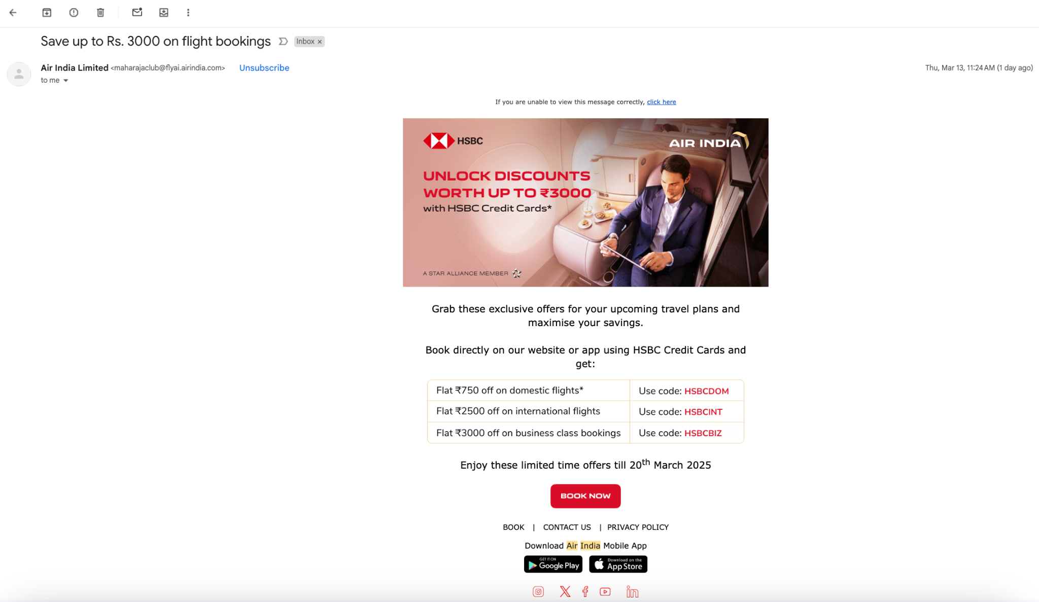
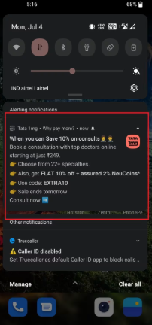
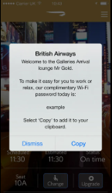
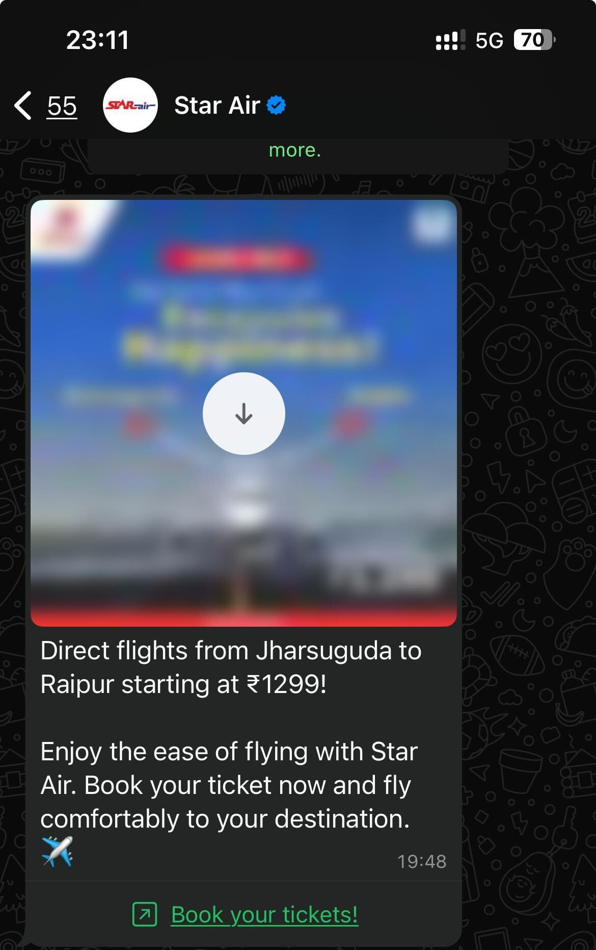
Keeping Flyers Hooked: The Ads That Drive Repeat Bookings
Remarketing Ads (Abandoned cart, price drop alerts)
Loyalty Ads (Exclusive IndiGo deals for frequent flyers)
App Push Notifications & SMS
WhatsApp Marketing
Key Messaging Suggestion - Special Offer Just for You! Book now & get ₹500 off your next flight. Limited seats available!
Notes:
Design:
✅ Showcase email marketing campaigns, push notifications, and loyalty program creatives.
✅ Use customer testimonials or app store reviews to reinforce trust.
✅ Display an Indigo mobile app mockup with a “Member-Only Deals” message.

Slide 29
Media Plan

Slide 30
Brand Awareness - Media Plan/Estimations (First 3 Months)
Objective | Platform | Ad Types | Daily Budget | Daily Impressions | Daily Clicks | CTR | CPC | CPM
Awareness | Google Ads | Display | ₹500 | 15K-65K | 200-500 | 0.5%-1.5% | ₹1-₹2.5 | ₹7.61-₹56.2
 |  | Demand Gen Video Ads | ₹800 | 14K-38K | 500-1200 | 2%-3.2% | ₹0.66-₹1.6 | ₹21.05-₹57.2
 | Meta Ads | Traffic Campaign (Image, Video & Carousel Ads) | ₹1,200 | 19K-55K | 371-1.1K | 1.5%-2% | ₹1.09-₹3.24 | ₹21.81-₹63.15
 | Quora | Traffic Campaign (Text, Image and Video Ads) | ₹400 | 1K-5K | 30-150 | 2%-3% | ₹2.67-₹13.3 | ₹80-₹400
Objective | Platform | Ad Types | Daily Budget | Daily Reach | Daily Clicks | Daily Leads | Cost/Lead
Lead Gen | Google Ads | Search | ₹300 | 4K-10K | 200-500 | 3-5 | ₹100-₹150
 |  | Local Pmax | ₹500 | 10K-25K | 300-600 | 1-5 | ₹100-₹500
 | Meta Ads | Call Ads | ₹400 | 11K-32K | 150-350 | 23-66 | ₹10-₹20
 |  | Lead-Gen Ads | ₹600 | 16K-47K | 240-500 | 20-56 | ₹50-₹80

Slide 31
Consideration - Media Plan/Estimations (First 3 Months)
Objective | Platform | Ad Types | Daily Budget | Daily Impressions | Daily Clicks | CTR | CPC | CPM
Awareness | Google Ads | Display | ₹500 | 15K-65K | 200-500 | 0.5%-1.5% | ₹1-₹2.5 | ₹7.61-₹56.2
 |  | Demand Gen Video Ads | ₹800 | 14K-38K | 500-1200 | 2%-3.2% | ₹0.66-₹1.6 | ₹21.05-₹57.2
 | Meta Ads | Traffic Campaign (Image, Video & Carousel Ads) | ₹1,200 | 19K-55K | 371-1.1K | 1.5%-2% | ₹1.09-₹3.24 | ₹21.81-₹63.15
 | Quora | Traffic Campaign (Text, Image and Video Ads) | ₹400 | 1K-5K | 30-150 | 2%-3% | ₹2.67-₹13.3 | ₹80-₹400
Objective | Platform | Ad Types | Daily Budget | Daily Reach | Daily Clicks | Daily Leads | Cost/Lead
Lead Gen | Google Ads | Search | ₹300 | 4K-10K | 200-500 | 3-5 | ₹100-₹150
 |  | Local Pmax | ₹500 | 10K-25K | 300-600 | 1-5 | ₹100-₹500
 | Meta Ads | Call Ads | ₹400 | 11K-32K | 150-350 | 23-66 | ₹10-₹20
 |  | Lead-Gen Ads | ₹600 | 16K-47K | 240-500 | 20-56 | ₹50-₹80

Slide 32
Conversion - Media Plan/Estimations (First 3 Months)
Objective | Platform | Ad Types | Daily Budget | Daily Impressions | Daily Clicks | CTR | CPC | CPM
Awareness | Google Ads | Display | ₹500 | 15K-65K | 200-500 | 0.5%-1.5% | ₹1-₹2.5 | ₹7.61-₹56.2
 |  | Demand Gen Video Ads | ₹800 | 14K-38K | 500-1200 | 2%-3.2% | ₹0.66-₹1.6 | ₹21.05-₹57.2
 | Meta Ads | Traffic Campaign (Image, Video & Carousel Ads) | ₹1,200 | 19K-55K | 371-1.1K | 1.5%-2% | ₹1.09-₹3.24 | ₹21.81-₹63.15
 | Quora | Traffic Campaign (Text, Image and Video Ads) | ₹400 | 1K-5K | 30-150 | 2%-3% | ₹2.67-₹13.3 | ₹80-₹400
Objective | Platform | Ad Types | Daily Budget | Daily Reach | Daily Clicks | Daily Leads | Cost/Lead
Lead Gen | Google Ads | Search | ₹300 | 4K-10K | 200-500 | 3-5 | ₹100-₹150
 |  | Local Pmax | ₹500 | 10K-25K | 300-600 | 1-5 | ₹100-₹500
 | Meta Ads | Call Ads | ₹400 | 11K-32K | 150-350 | 23-66 | ₹10-₹20
 |  | Lead-Gen Ads | ₹600 | 16K-47K | 240-500 | 20-56 | ₹50-₹80

Slide 33
Let’s Take Indigo to 40% Direct Bookings Together!

Slide 34
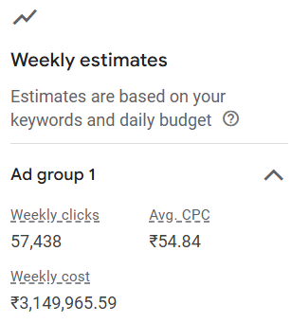
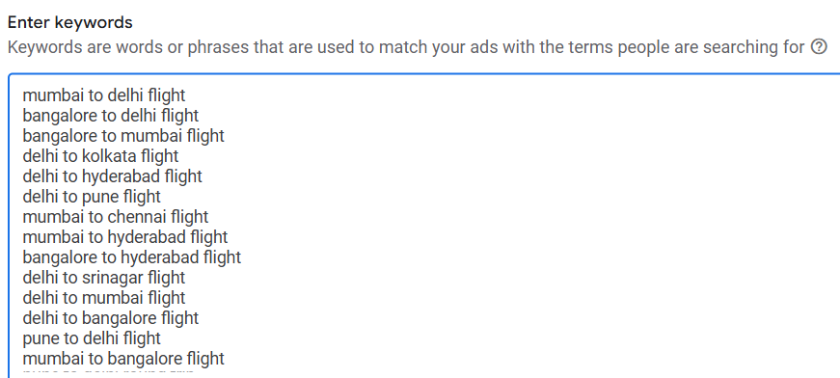
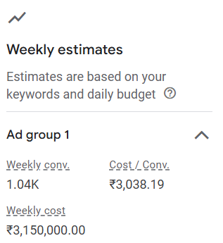

Slide 35
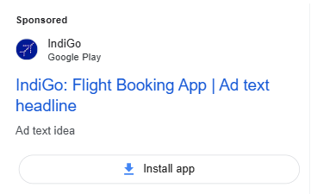
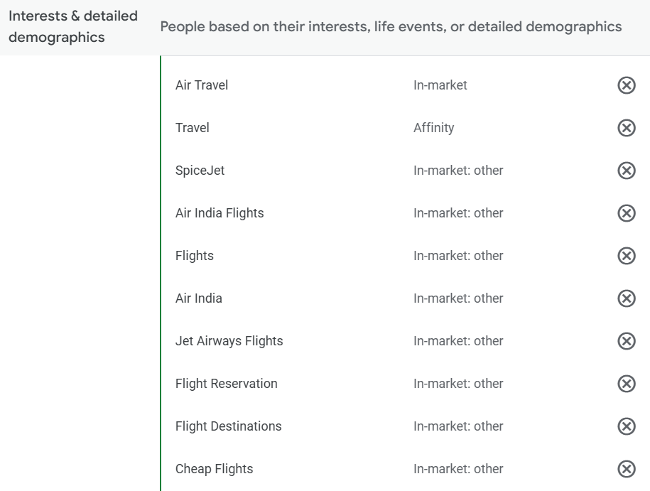
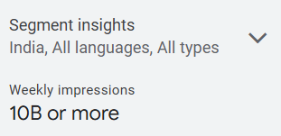
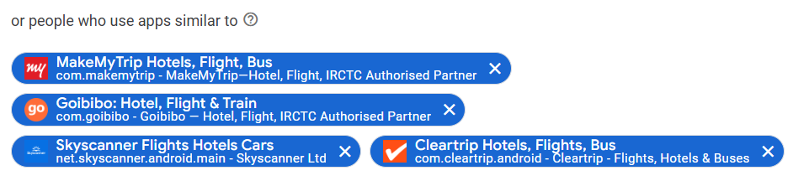

Slide 36
